Slide 1

SES/SRM Webinar Presentation 4 Responding to SRM Requests

Slide 2
Outline
Overview of SRM request and response process
  Seven steps in the Response Process
    Key issues in assessing eligibility, developing and implementing responses
  Additional resources and request for your feedback

Slide 3
Stakeholder Response Mechanism
Requests for SRM from affected stakeholders
SRM-HQ in BPPS
Country Office Focal Point (CFP) for SRM
Country-level process for dispute resolution
1st recourse: National partners’ management and grievance redress mechanisms (GRMs)
2nd: UNDP program/project management
3rd: CO SRM managed by CFP
Corporate tracking and oversight of requests
option for SRM-HQ involvement if requested/needed
SRM-HQ refers compliance issues to SECU
Regular reporting, case
consultation, joint learning
Oversight and support
as needed from Regional Bureau
Regional Service Center and Regional Bureau

Slide 4
SRM Response: A 7-Step Process
Receive and register the SRM Request
Acknowledge, assess, and assign responsibility
Develop and propose a response to the requester
Seek agreement on the response with the requester
Implement the agreed response; close if successful
Review and revise approach if necessary
Close the case; if SRM has not succeeded in addressing concerns, option to refer requester to other mechanism(s)
Guidance Note (available from UNDP SRM web page): UNDP Stakeholder Response Mechanism: Overview and Guidance
Annex A: Step-by-step Guidance

Slide 6
1. Receive and register the SRM Request
Request can come either to CO or to HQ
Expectation that most requests will be filed online through CO or HQ Web page
  SRM Web page and form ask requester for specific information
Initial requests can be made orally or in writing
  Oral requests ultimately need to be submitted in writing by or on behalf of the Requester; UNDP SRM staff may assist
Requests submitted online automatically entered into SRM Case Management System (CMS)
Requests submitted in other formats need to be entered into CMS by CFP or HQ SRM staff
Once entered into CMS, requests will be automatically forwarded to relevant CFP, HQ SRM staff, and Regional Bureau Focal point

Slide 7
2. Acknowledge, assess, and assign responsibility
Receiver (CFP or HQ SRM) acknowledges receipt within 3 business days
  If additional information is needed to assess eligibility, receiver asks requester for that additional information
Receiver determines SRM eligibility using criteria (next slide), within 5 business days of receipt; may require consultation between HQ SRM and CFP
Normally CFP will take leadership for the response; exceptions when:
  Requester has raised concerns about CO (Region or HQ leads);
  Requester has not yet engaged with Implementing Partner and UNDP project management (receiver refers requester to them); or
  Compliance issues raised by requester, or by SECU (SRM and SECU staff need to clarify SRM-SECU tracks and discuss sequence with the requester)

Slide 8
What makes an SRM request eligible?
Relates to a current or proposed UNDP project
  For proposed projects: there must be a UNDP Project Concept document and/or draft Project Document
  Requester may not know project status; UNDP SRM staff are responsible for clarifying internally to determine eligibility
Explains how the requestors have been experiencing or may experience adverse socio-economic or environmental impacts from the UNDP project
  Requester does not have to prove impacts have occurred or that risks are severe, only needs to make it clear why they are concerned
Indicates what steps have already been taken to try to resolve the grievance or dispute, e.g.
    Communication with Implementing Partner/use of its grievance mechanism
    Communication with UNDP project developer/manager
  Requester may have good reasons for not having raised concerns with Implementing Partner or UNDP project management, but does need to make those reasons clear

Slide 9
3. Develop and propose a response to the requester
SRM lead has four main response options:
Indicate that the request is ineligible, and explain why
Refer the requestor to a more appropriate grievance mechanism, and explain why
Propose direct action by the Country Office to resolve the grievance/dispute
Propose further consultation by UNDP with the requestor and other stakeholders to determine jointly the best way to resolve the grievance/ dispute

Slide 10
Key considerations in developing a response
Prior efforts to resolve the concern with Implementing Partner/UNDP project management (considering requester concerns about IP or UNDP project management, and maintaining confidentiality if requester has asked for it)
Opportunity for relatively straightforward action by the CO (by project or CO management) to address the concern/grievance
Need for additional consultation with requester, Implementing Partner, UNDP project managers, and/or other stakeholders to understand perceptions and interests; clarify facts and issues; and develop options jointly
  In highly complex cases, consider use of external, credible mediator/facilitator
CFP and HQ SRM (and Regional Bureau if it chooses an active role) should seek alignment before proposing response to requester
Lead for the particular case makes final decision on proposed response, within 15 business days of acknowledging a complete request

Slide 12
4. Seek agreement on the response with the requester
Lead communicates proposed response to the requester, with explanation
Requester has option to accept proposed response, seek modification or reject
If requester accepts proposed response, then proceed;
if not then…
Lead (in consultation with others involved internally) determines how to handle requests for modification and rejections; should make good faith effort to understand and be responsive to the requester
If no agreement with requester on UNDP response can be achieved, SRM lead documents proposed response, dialogue with requester, requester’s reasons for rejection
Lead should communicate to requester that UNDP has made a good faith effort to respond, and that the requester is free to pursue other options to address the concerns raised

Slide 13
5. Implement the agreed response; close if successful
For “simple” responses by the Implementing Partner and/or UNDP project management, SRM lead checks to confirm that response has been implemented and requester is satisfied
When there is agreement on the need for an initial round of consultation, SRM lead consults with stakeholders to clarify issues, concerns and options, or supports an independent assessment
Based on results of consultation/assessment, SRM lead may
  Facilitate dialogue and problem solving
  Support independent or joint fact finding
  Support independent mediation
  If one of these responses is successfully implemented, SRM documents resolution satisfactory to requester and other stakeholders, and closes the case

Slide 14
6. Review and revise approach if necessary
If a “simple” response does not fully address the requester’s concerns, then SRM lead needs to clarify why not, and determine what further response might be helpful and feasible
If consultation/assessment concludes that a collaborative approach is unlikely to succeed, SRM lead may recommend that the requester pursue other (non-SRM) options
If a collaborative option (joint fact-finding, dialogue, negotiation) is undertaken but does not succeed, SRM lead may work with stakeholders to overcome obstacles, or try a different type of collaborative approach

Slide 15
7. Close or refer the case
SRM lead should
Document case resolution (whether successful or not) in the CMS (automatically shared with other SRM actors)
Share summary of process and result with requester, UNDP CO/project management, Implementing Partner, and other stakeholders
  Joint decision of UNDP and stakeholders on level of detail to be shared publicly
Clarify any conditions under which requester or other stakeholders might seek additional assistance from the SRM on the case, and any ongoing monitoring role for the SRM lead
Note lessons learned that may be helpful at the project, programme or national level to prevent or resolve future grievances/disputes
When the requester has asked for a referral to another mechanism, provide appropriate assistance and document the referral

Slide 16
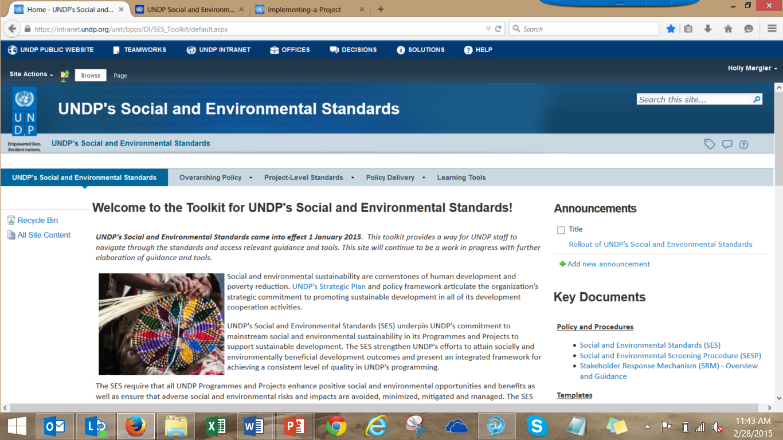
Learn More
SES Toolkit: intranet.undp.org/unit/bpps/DI/SES_Toolkit
SES Public Website: www.undp.org/ses
SECU/SRM Public Website: www.undp.org/secu-srm
Notes:
Toolkit provides templates for the SESP and additional tools and guidance

